Slide 1
W207 MACHINE LEARNING WORK IN PROGRESS

Slide 2
Table of Contents
Unit01 Introduction
Unit02 K-Nearest Neighbor
Unit03 Naïve Bayes

Slide 3
6+2 Questions To Understand Any Machine Learning Algorithm
How do you refer to the technique (e.g. what name)?
How do you represent a learned model (e.g. what coefficients)?
How do you learn a model (e.g. the optimization process from data to the representation)?
How do you make predictions from a learned model (e.g. apply the model to new data)?
How do you best prepare your data for the modeling with the technique (e.g. assumptions)?
How do you get more information on the technique (e.g. where to look)?
What problem is the technique suited for?
What are advantages and disadvantages of the technique?
https://machinelearningmastery.com/question-to-understand-any-machine-learning-algorithm/

Slide 4
K-Nearest Neighbor
Type: Distance-based algorithm, lazy learner, instance-based learning algorithm
Representation: NA
Learning: The model doesn’t explicitly learn the data. Instead, it memorizes the training instances which are subsequently used as knowledge for prediction phase.
Predictions:
Compute distance between new data-set x and training observations. We call the k points in the training data that are closest to x the set A. (Note that K is usually odd to prevent situations)
Input x gets assigned to the class with the largest number of votes.
Model preparation: Feature scaling.
Problem to solve: Computer vision, recommender systems
Advantage: Easy to interpret, predictive power, can handle extreme multi-class problems
Disadvantage: Expensive and slow to predict new instances. Requires dimension reduction. Sensitive to outlier. Doesn’t handle categorical data well.
Hyperparameters to tune:
K: number of neighbors. Smaller k leads to overfitting(variance) while larger k leads to high bias.
Distance function:

Slide 5
K-Nearest Neighbor – Key Visualizations

Slide 6
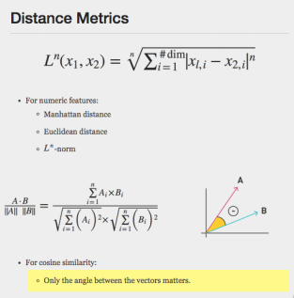
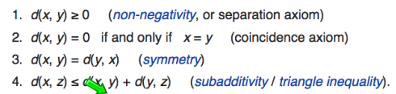
Distance Metrics
Distance “Measure” can be anything
Distance metric is specific

Slide 7
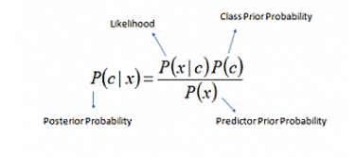
Naïve Bayes
Type: Probability-based model
Representation:
Learning:
Describe probability of class C given the features provided
Compute parameters to maximize the probability of getting the features given class C (MLE)
Predictions:
Plug and play
Model preparation: 1) “Naïve” assumptions are that all of the features in the dataset are equally important and independent. 2) Each feature must be categorical in order to create the combinations of class and features values comprising the matrix
Problem to solve: Text classification, Spam detection, Real time prediction
Advantage: Simple, fast (easy to parallelize, just to count), does well with noisy and missing data,
Disadvantage: Not ideal for datasets with large number of numeric features,
Hyperparameters to tune: Conditional probabilities.
http://scikit-learn.org/stable/modules/naive_bayes.html

Slide 8
Laplace smoothing

